Slide 1
Walkthrough for FOL_Verifier and Random_Program_Creation
Monday Meeting Presentation (8/3/20)
Josh Cooper

Slide 2
Overview
 | FOL_Verifier.py | Random_Program_Creation
Main Purpose | Given a list of eBPF instructions, attempts to evaluate the final state of the registers using only first order logic | Automate the creation of random test programs to feed into FOL_Verifier and BPF_Step to check for correctness and agreement
Current Drawbacks | Limited subset of allowed eBPF instructions (only adds, movs, and JNE instructions coded so far) | Creates a randomized program which has few guarantees of running smoothly

Slide 3
Specifics about FOL_Verifier
Internal Logic for Naming Scheme and Storage
Valid Input checks/extensions
Supported eBPF Functions and Logic
How a Program is Interpreted and Checked
Sample Program Execution

Slide 4
Naming Scheme
SSA Naming Scheme for each individual register, highlighting at which specific instruction said register was changed.
Example Name: r1_3
This would indicate that register 1 was changed to a specific value during instruction 3 in the given program, not that register 1 has been changed 3 times since initialization

Slide 5
Initialization and Storage
Create_register_list function
Used to initialize a 2D List of registers to hold changed names over time.
Creates a list of Register_Info objects, which hold a BitVec z3 object with a pre defined size (more on that later), and the option to define a reg type (not used yet, but will be helpful to differentiate pointer/int values)
The special _start name is used to tell the program that a register hasn’t been initialized yet

Slide 6
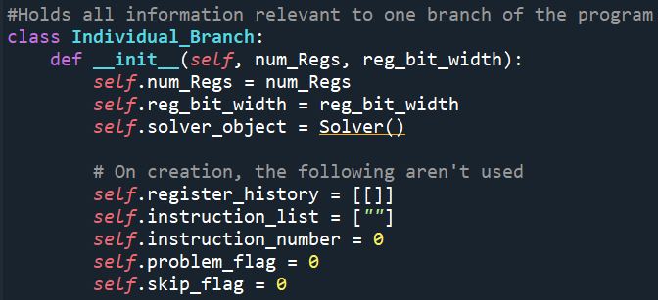
Register_state_helper
The main holder of information about the current program
Solver_object is the z3 solver which holds all constraints
Register_history is the list of all names of registers and their changes
Instruction_list is the actual sequence of eBPF commands to execute

Slide 7
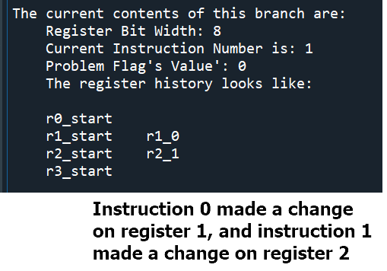
Growing the lists with each instruction
Every time an instruction needs to make a change on a register, a new Register_Info object is created, named, and appended on to the appropriate sublist in register_state_helper

Slide 8
Valid Input Checks and Extensions
Three types of input values supported in the current FOL_Verifier.
i4
Indicates an outside constant, with a bitsize that is half the size of the registers used in the current run of the program (ie 0xF)
i8
Outside constant, with a bitsize that matches the register size (ie 0xFF)
R
A value already stored in a register in the program

Slide 9
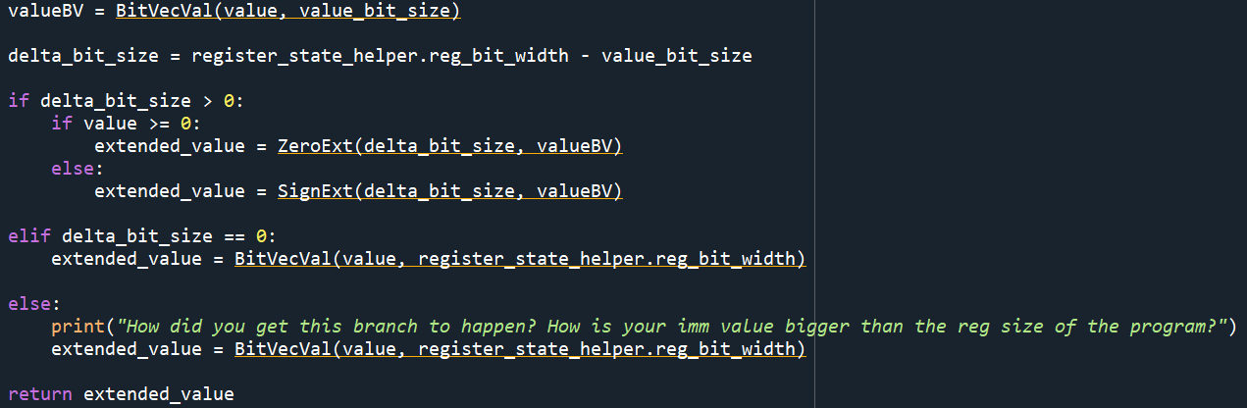
i4 Sign Extensions
Since all registers are of a defined size, any input that is classed as I4 would need to be scaled up to properly fit in the register.
But, if it is a signed value, we need to perform a sign extension up to the new register size.
Also, any positive value needs to be zero extended due to z3 bitvec rules.

Slide 10
Getting the Names of the registers and setting up input Values
Get_the_locations_and_extend()
This functions takes care of any sign/zero extensions for I4 source values, and also returns the names of the most recent versions of the target register (where the instructions might be placing a value) and the source register if it is being used.
It also takes care of creating the new instance of the targeted register
The returned list is used to reference the proper SSA’d names of register instances, or to hold a BitVectorConstant if the source_val was passed in as an i4 or i8 outside value

Slide 11
Supported EBPF Functions (as of 8/2/2020)
Add two values (BPF_ADD)
Add_two_values
Move a value into a register (BPF_MOV)
Mov_to_reg
Jump to a new instruction if a comparison isn’t equal (BPF_JNE)
Jump_general

Slide 12
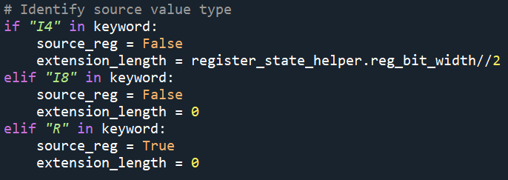
Choosing input values
All three general eBPF functions have specific parameters to indicate whether or not they’re using an i4, i8 or register source value
Source_reg is a Boolean, when True, input_val is treated as a register value, when false, input_val is assumed to be a number
Extension_length indicates how much input_val needs to be bit extended to match the register size

Slide 13
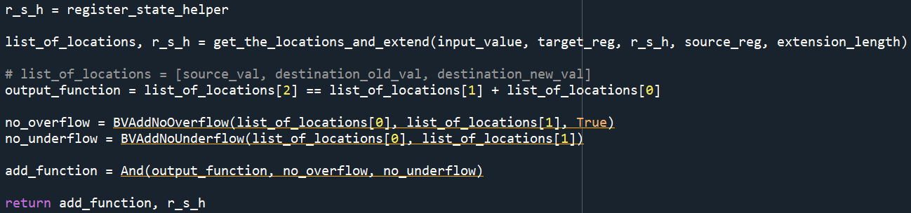
Add_two_values
General Function for addition
Enforces two safety constraints
No overflow if adding two positive values
No underflow if adding two negative values

Slide 14
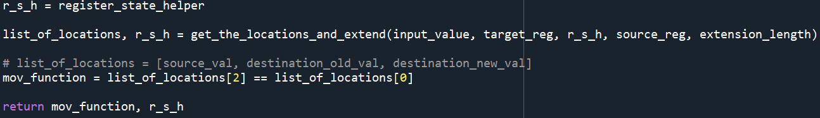
Mov_to_reg
Used for setting a register to a specific value,
Will also be used to make sure a register is live before using it in other instructions (liveness not implemented yet)

Slide 15
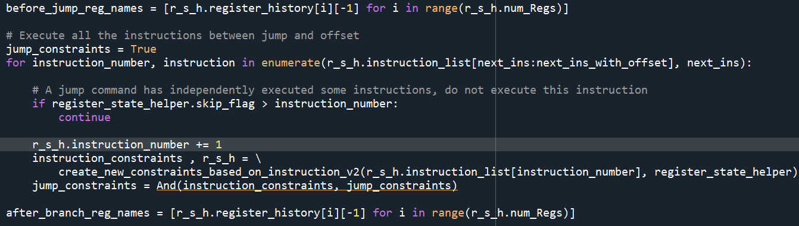
Jump_general
Actions Taken
1) Get the names of the registers before the jump is executed
2) Execute all instructions up to just before the offset instruction
3) Get the names of the registers after any changes made during step 2

Slide 16
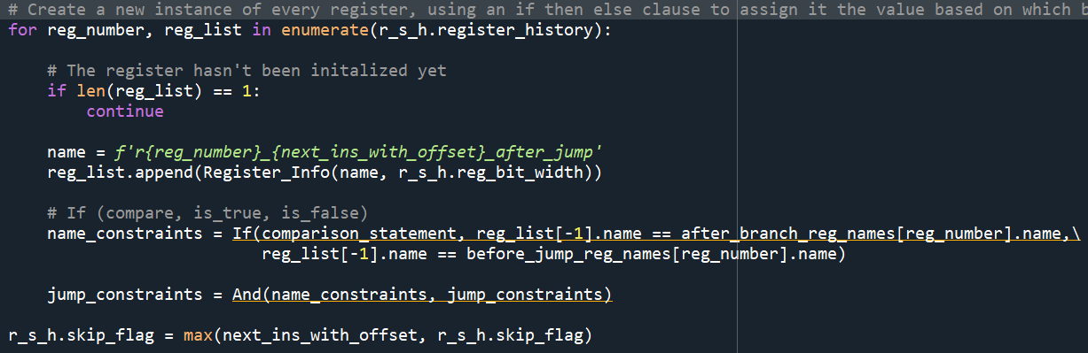
Jump_general ctd.
4) Create a new register instance holding an if/then/else constraint.
If the jump condition is valid, it will set the new register value to the values gotten from step 3
If the jump condition is not valid, the new register values will be set to the values in step 1
5) Return any constraints generated by the instructions in step 2, and the new register values from step 4
6) Set the skip flag to the offset instruction number to tell the main program not to double execute the instructions from the branch

Slide 17
How a Full Program is Interpreted and Checked
Three Main Functions
Create_program()
User facing function, takes in instruction_list, num_of_regs, and reg_bit_width
Execute_program()
Main workhorse, iterates through instruction_list and generates constrains due to each individual instruction via calls to create_new_constraints function
When through the list, will check for problem_flags to indicate an unsat solution, or will print out the results of the instructions
Create_new_constraints_based_on_instruction()
Splits an individual instruction and applies the correct subfunction

Slide 18
Execute_program
Once a program completes, or a problem flag is thrown, execute_program does three more things.
First, it prints out the most up to date version of the z3 solver, showing how all the registers changed over time.
Then, it prints out the current values held by the registers.
Finally, it prints out an automatic translation of the input program in bpf_step macro form, so you can copy/paste it and verify the results using the eBPF Verifier itself.
This last step will eventually be automated

Slide 19

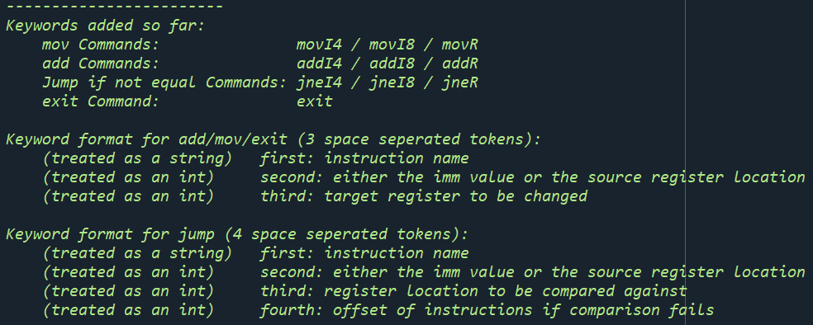
Create_new_constraints
Current set of allowed keywords:

Slide 20
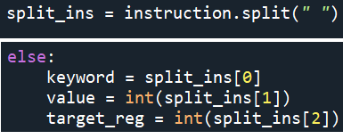

Creates_new_constraints
When given an instruction, it splits the individual instruction into space separated tokens, and deals with them one by one
Keyword indicates both the type of function (add, mov, jne) and also the type of the value number( i4, i8, register)
Value will be either the number to be input to a calculation, or the location of the source regiser to take a value from
Target_reg is the location where we put the result of a calculation
For jne instructions, there will be a 4th token telling how much of an offset to jump to after the jump instruction

Slide 21
Creates_new_constraints ctd.
Every instruction returns :
A set of new constraints to add to the z3 solver
An updated register_state_helper, with:
New register names
Any problem_flags that might have occurred
Any skip_flags that might be generated by the jump_general function

Slide 22
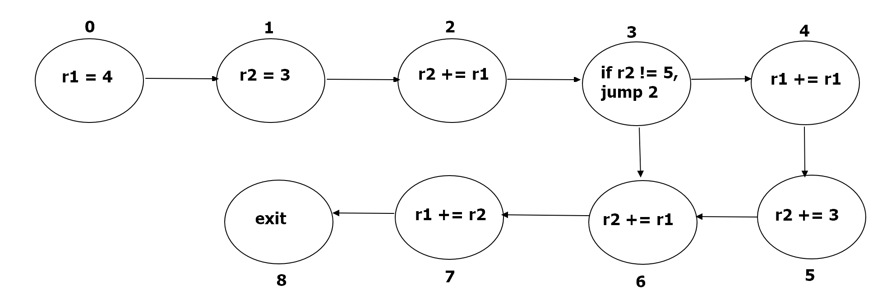
Sample Program

Slide 23
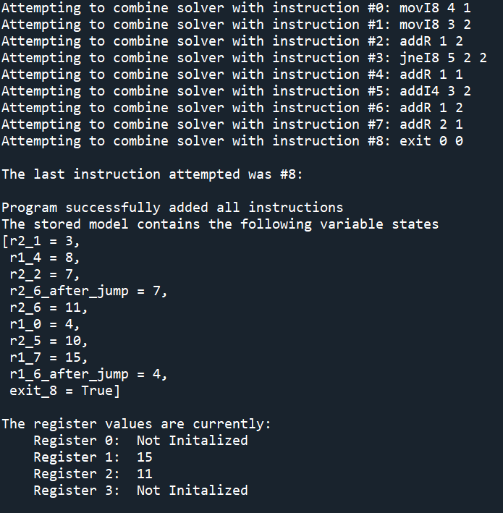
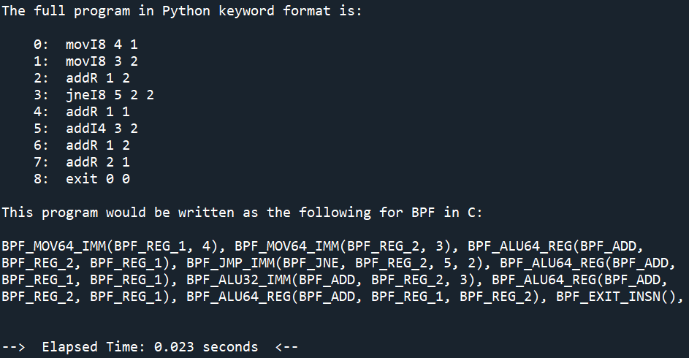
Full Run of a Sample Program

Slide 24
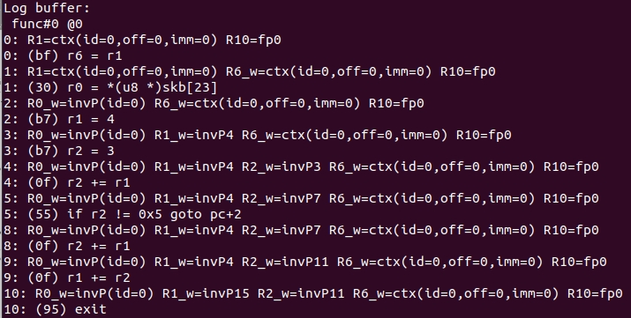
Sample Program in bpf_Step

Slide 25
Future Features for FOL
1) More instructions supported
Probably can do most of the arithmetic instructions
Haven’t thought about map access/memory access yet
2) Generalize the jump function
BPF_JMP is a general function which supports all the distinct jump types
Want to change the way I execute the compare condition to be modular
3) Make a print function to make the model output less random
There is very little order to how the z3 model outputs its solution
First thoughts is to have some kind of print function which iterates down a specific register sublist

Slide 26
Random_Program_Creator
Why write tests yourself when you can have a program do it for you!
Three main features
Guarantee that any register called in an instruction has been initialized
Liveness idea prototype that I need to bring into FOL_Verifier
Guarantee that any jump function has an offset that places it within the scope of the instructions
Cannot have a jump function jump 30 instructions forward on a program with only 10 instructions
Guarantee that the last instruction is always an exit command

Slide 27
Eventual automation
Once Random_Program_Creation actually starts creating useful programs, we’ll need a way of automating their translation, and loading, into bpf_step
Translate_to_bpf_in_c()
Does a one to one translation of each individual FOL_Verifier instruction into the appropriate BPF_Step macro
Outputs a single string which can be directly copied into a C program and run without changes to the string

